Slide 1
Automating reports with Python
NorCal IUG 2017
November 17, 2017
www.gemstonelogan.com/presentations.html

Slide 2
Why Automate?
Staff time
Allows more time for other things
Reports are delivered on a consistent schedule
Will work while staff is on vacation, in meetings, sick, etc.
Reduces repetitive work

Slide 4
How?
Simple solution: Use a combination of bat files, SQL scripts, Blat, and Scheduled Tasks
Pros: Relatively simple
Cons: Limiting formatting
More robust: Use a programming language, SQL script (or API), bat file, and Scheduled Tasks
Pros: Very customizable and can create beautiful spreadsheets
Cons: More initial setup

Slide 5
One Approach
Install Python

Slide 6
Installing Python: Anaconda https://www.anaconda.com/download/

Slide 7
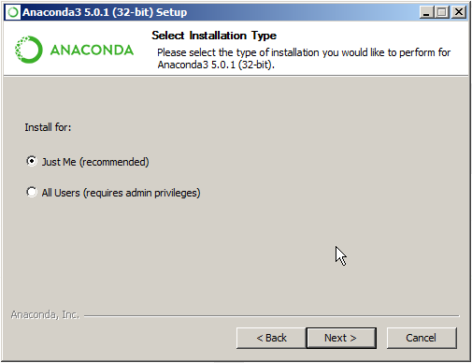

Slide 8
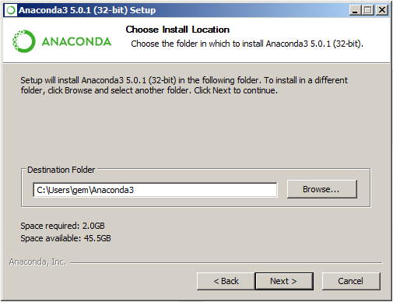

Slide 9
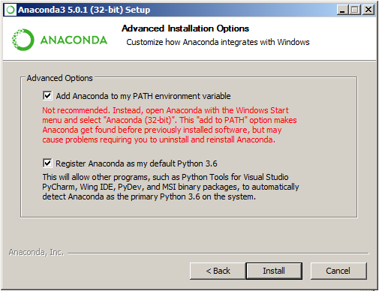

Slide 10
One Approach
Write a one-line program and test
Add a shebang line and doc string
Refine your existing code (comment, reorganize, add variable, etc)

Slide 11
Editors: Any Plain Text Editor
Notepad
Any Windows computer will have this
Simple – probably too simple
Notepad++
Syntax highlighting, substantial improvement over Notepad
Geany
Easy to run Python straight from the editor
gVim
Not a good beginning editor

Slide 12
One-line Python program

Slide 13
Running a program
C:\Users\gemst\Documents\IUG2018\WeeklyNew>python hello.py
Hello World
(This assumes you added Python to your path during installation.)

Slide 14
Add a shebang line and doc string
#!/usr/bin/env python3
"""Print Hello World to the command line."""
# Print "Hello World"
print ("Hello World!")

Slide 15
One Approach (Continued)
Try creating an empty spreadsheet with xlsxwriter
Add some formatting
Try writing some text to the spreadsheet
Refine your existing code (comment, reorganize, add variable, etc)

Slide 16
Creating a Spreadsheet
#!/usr/bin/env python3
"""Create a spreadsheet."""
import xlsxwriter
#Creating the Excel file for staff
workbook = xlsxwriter.Workbook('test.xlsx')
worksheet = workbook.add_worksheet()
http://xlsxwriter.readthedocs.io/

Slide 17
One Approach (continued)
Connect to a database
Submit a query to the database (test your SQL first)
Print results
Write results to your spreadsheet
Refine your existing code (comment, reorganize, add variable, etc)

Slide 18
Module for Connecting to a Database
Sierra uses a PostgreSQL database for many things
Python module: psycopg2
I believe Polaris uses Microsoft SQL Server database
Python module: pymssql

Slide 19
Connect to a Sierra database
#!/usr/bin/env python3
"""Connect to Sierra database."""
import psycopg2
import xlsxwriter
conn = psycopg2.connect("dbname='iii' user='' host='' port='' password='' sslmode='require'")
https://wiki.postgresql.org/wiki/Psycopg2_Tutorial

Slide 20
Python: Modules/Packages
Anaconda already includes many useful packages
Example error when a necessary package is not installed:
C:\Users\gemst\Documents\IUG2018\WeeklyNew>python weeklynew.py
Traceback (most recent call last):
File "weeklynew.py", line 10, in <module>
import psycopg2
ImportError: No module named 'psycopg2'

Slide 21
Python: Installing Modules/Packages
python -m pip install psycopg2
https://docs.python.org/3/installing/

Slide 22
Python: Installing Modules/Packages
OR
conda search psycopg2
conda install psycopg2
(https://conda.io/docs/using/pkgs.html)

Slide 23
Python: Installing Modules/Packages
Collecting psycopg2
Downloading psycopg2-2.7.1-cp35-cp35m-win_amd64.whl (939kB)
100% |################################| 942kB 884kB/s
Installing collected packages: psycopg2
Successfully installed psycopg2-2.7.1

Slide 24
Writing Your Query (Sierra focus)
SQL
Currently recommended when creating reports
CANNOT modify data (no create, delete, or update)
Some data doesn’t live in the PostgreSQL database
Sierra APIs
Actively being developed but currently has some significant gaps
Results are currently significantly slower than SQL
CAN Create, Update, and Delete selected data
Create List is designed as a standalone tool and will not work well for automating reports

Slide 25
One Approach (continued)
Create an email
Send the email
Refine your existing code (comment, reorganize, add variable, etc)

Slide 26
One Approach (continued)
Create a Windows bat file that can run your Python program
Use Task Scheduler to schedule your bat file to run automatically

Slide 27
weeklynew.bat (example)
@echo off
"C:\pythonw.exe" "C:\Users\gemst\weeklynew.py"
Python Location Your Program Location
Figure out where Python is installed
Open cmd
Type where python

Slide 28
Automating: Task Scheduler
Click Windows icon and search for Task Scheduler
Under Actions choose Create Task
Provide a name
Click the Triggers tab and New to choose the schedule (make sure Enabled is checked)
Click the Actions tab and choose New
Action is Start a program
Browse to where you bat file is stored
Start in should include the path to your program

Slide 29
Programming Tips
Start with a goal but do little bits at a time
Google your error messages (results from Stack Overflow are particular good)
Double check sample code matches your Python version
Don’t try to be perfect
Ask for help
Be persistent

Slide 30
Additional Resources and Troubleshooting
Python Crash Course by Eric Matthes
My favorite Python book so far
Google
Stack Overflow
https://stackoverflow.com/
One of the best places to find answers to programming questions

Slide 31
Contact Information
Gem Stone-Logan
gem.stone-logan@mountainview.gov
Technology Librarian
Mountain View Public Library
Mountain View, CA
Slides: www.gemstonelogan.com/presentations.html

