Slide 1
Automating Reports with Python
Gem Stone-Logan
gemstonelogan@gmail.com
Technology Librarian
Mountain View Public Library
Mountain View, CA

Slide 2
Automating Reports with Python: Agenda
Installing Python on Windows as a regular user
Basic Requirements
Use SQL with Python
Create an Excel spreadsheet
Email the report
Automate with Task Scheduler
NOTE: This script connects to a PostgreSQL database. However, the general concept should be the same for most other databases.

Slide 3
Writing Your Query (Sierra)
SQL
Currently recommended when creating reports
CANNOT modify data (no create, delete, or update)
Some data doesn’t live in the PostgreSQL database
Sierra APIs
Actively being developed but currently has some significant gaps
Results are currently significantly slower than SQL
CAN Create, Update, and Delete selected data
Create List is designed as a standalone tool and
will not work well for automating reports

Slide 4
Writing the SQL
SQL Searching in the Find Tool, or How to Find What You Didn't Know You Could
presented by JT Whitfield and Renee Patterson (Polaris)
4/25/2018 4:30 PM – 5:30 PM
Oceans 1 & 2
A Gentle Introduction to Sierra SQL presented by Phil Shirley (Sierra)
4/26/2018 9:00AM – 10:00AM
Odyssey

Slide 5
Why Automate?
Staff time
  Allow more time for other things
  Will work while staff is on vacation
Reduces boring work
Reports are delivered on a consistent schedule

Slide 6
Manually Create the Report
Task | One Time | Every Time
Report Requirements | x
Write/Refine SQL | x
Open pgAdmin, Connect to DB |  | x
Open SQL session and copy SQL |  | x
Execute and save data |  | x
Open Excel and format worksheet |  | x
Import data and save results |  | x
Email to staff |  | x

Slide 7
Automate the Report
Task | One Time | Every Time
Report Requirements | x
Write/Refine SQL | x
Open pgAdmin, Connect to DB | x
Open SQL session and copy SQL | x
Execute and save data | x
Open Excel and format worksheet | x
Import data and save results | x
Email to staff | x
Create Batch file and Setup Task Scheduler | x

Slide 8
What do I want to do?
Pull a list of new items, insert into a nicely formatted spreadsheet, and then email to staff. This requires:
Connecting to a database
Querying the database with SQL
Creating the spreadsheet
Importing data into the spreadsheet
Creating an email
Sending the email
Automate it

Slide 9
Installing Python
Python 3.6
Better than version 2 if learning Python for the first time
Much better unicode support
Anaconda Distribution
Contains many useful Python packages (add-ins) already
Pip OR Conda
Used for installing additional packages

Slide 10
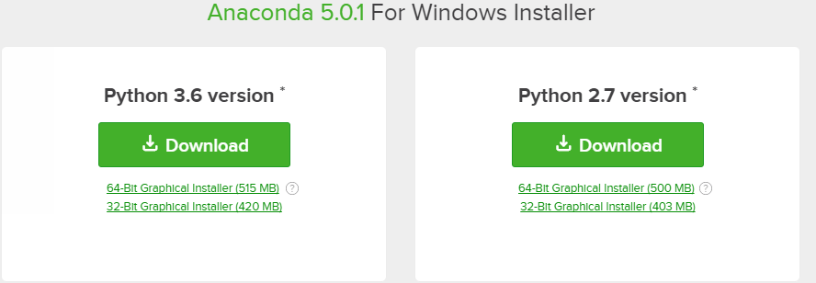
Installing Python: Anaconda
https://www.anaconda.com/download/

Slide 11
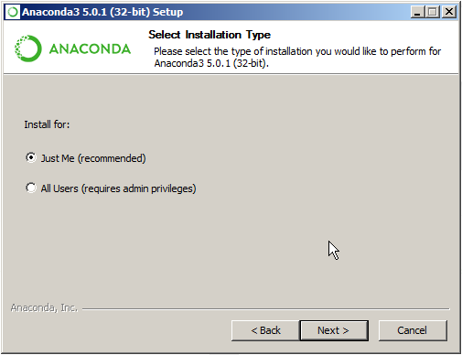
Installing Python: Anaconda

Slide 12
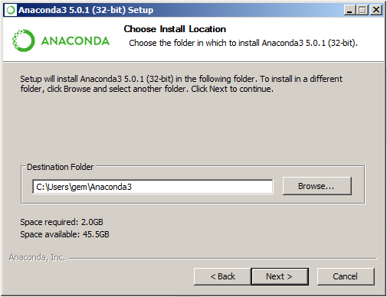
Installing Python: Anaconda

Slide 13
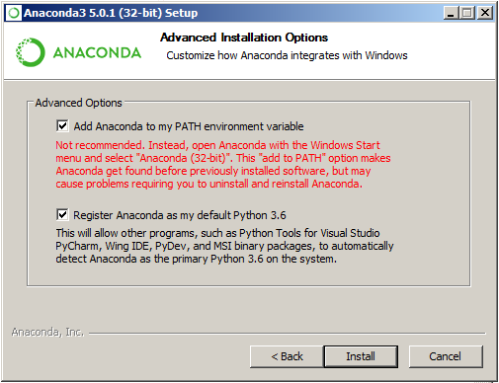
Installing Python: Anaconda

Slide 14
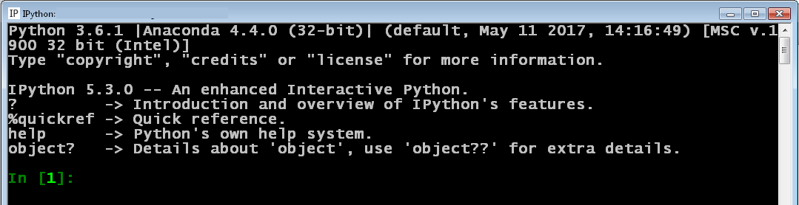
Interactive Shell
IPython – comes with Anaconda
Great for practicing
This is NOT the Windows Command Prompt. Python commands
will not work on the Windows Command Prompt.
Notes:
print ('Hello World!')

Slide 15
Editors: Any Plain Text Editor
Notepad
Any Windows computer will have this
Simple – probably too simple
Notepad++
Syntax highlighting, substantial improvement over Notepad
Geany
Easy to run Python straight from the editor
gVim
Not a good beginning editor

Slide 16
Running a Script
Open up a Windows Command Prompt
Browse to where your script is located
Run the program
  If Python was added to your path, type:
  python [program name]
  If Python was not added to your path, you'll need to include the full path to Python and then include your program's name.
Notes:
See hello.py

Slide 17
Python: Shebang Line
Usually the “shebang” is the first line in a Python Script
Example: #!/usr/bin/env python3
Provides the reader a hint as to what this file is
It's not necessary in Windows but is good practice
Notes:
See weeklynew1.py

Slide 18
Python: Docstring
Explains what the script or function does
Starts and ends with 3 double quotes: “””
Notes:
http://www.pythonforbeginners.com/basics/python-docstrings

Slide 19
Python: Comments
Each comment line starts with a #
Use comments to explain what your program is doing

Slide 20
Python: Packages

Slide 21
Python: Missing Packages
C:\Users\gemst\Documents\IUG2017\WeeklyNew3_5Pres>python weeklynew1.py
Traceback (most recent call last):
File "weeklynew1.py", line 10, in <module>
import psycopg2
ImportError: No module named 'psycopg2'

Slide 22
Python: Packages
pip install psycopg2
OR
python -m pip install psycopg2
(https://docs.python.org/3/installing/)
OR
conda search psycopg2
conda install psycopg2
(https://conda.io/docs/user-guide/tasks/manage-pkgs.html)

Slide 23
Python: Packages
Collecting psycopg2
Downloading psycopg2-2.7.1-cp35-cp35m-win_amd64.whl (939kB)
100% |################################| 942kB 884kB/s
Installing collected packages: psycopg2
Successfully installed psycopg2-2.7.1

Slide 24
Python: SQL Server (Polaris people)
Polaris:
If you are turnkey or software only, you probably have access to SQL Server.
Many hosted libraries do not.
Assuming you have access, try using the pymssql module. To install, use the same syntax as for psycopg2. For example:
pip install pymssql
(http://www.pymssql.org/)
Notes:
Thanks to Wes Osborne at The Central Library Consortium for answer my questions about this.

Slide 25
Python: Connecting to PostegrSQL (back to Sierra)
conn = psycopg2.connect(“dbname='[database name]', user='[database user]', host='[host]', port='[port]',sslmode='require')
Notes:
See weeklynew2.py

Slide 26
Python: SQL
Open a database session:
cursor = conn.cursor()
Querying the database:
cursor.execute(open('[sql file]','r'.read())
OR
cursor.execute('[sql statement]')
OR
cursor.execute([varible with sql])
Notes:
The SQL file is in WeeklyNewItemsRev.sql
See weeklynew3.py for how to reference an external sql file
See weeklynew3ALT.py to see what an inline SQL example could look like

Slide 27
Python: SQL
Storing the SQL results for use later:
rows = cursor.fetchall()
Print, just to prove something happened:
print (rows)*
Closing the session:
conn.close()
* See the Printing Unicode slide at the end of this presentation.

Slide 28
Python: Creating an Excel Workbook
Module for creating an Excel spreadsheet with Python:
import xlsxwriter
Documentation:
http://xlsxwriter.readthedocs.io/index.html
Notes:
See weeklynew4.py

Slide 29
Python: Creating an Excel Workbook
Creating a new Excel workbook
workbook = xlsxwriter.Workbook('[file name]')
OR
workbook = xlsxwriter.Workbook([variable with filename])

Slide 30
Python: Creating an Excel Worksheet
Creating a new worksheet for our workbook
worksheet = workbook.add_worksheet()

Slide 31
Python: Excel Formatting
Change worksheet to landscape view (default is portrait)
worksheet.set_landscape()
When printing, print the grid lines
worksheet.hide_gridlines(0)
Notes:
See weeklynew5.py

Slide 32
Python: Add Cell Formatting
General syntax to specify cell formatting
workbook.add_format({})
Make dates appear as mm/dd/yy
workbook.add_format({'num_format' : 'mm/dd/yy'})
Make the text within a cell wrap
workbook.add_format({'text_wrap' : True})

Slide 33
Python: Add Cell Formatting
Align text at the top
workbook.add_format({'valign' : 'top'})
Make the font bold
workbook.add_format({'bold' : True})
Combine multiple formats together with a comma
workbook.add_format({'valign' : 'top', 'bold' : True})

Slide 34
Python: Changing Column Widths
Specifying a column's width manually using "A1 Notation"
worksheet.set_column('[first column:last column]',[column width])
For example, if we wanted to set just column C to a width of 12.71, it would look like this.
worksheet.set_column('C:C',12.71)
An alternative is to use a zero based index which we will use later when populating the data:
http://xlsxwriter.readthedocs.io/working_with_cell_notation.html

Slide 35
Python: Worksheet Header
Inserting a worksheet header
worksheet.set_header('[header content]')
Basic Header
worksheet.set_header('Weekly New List')
Lots of header customization options
http://xlsxwriter.readthedocs.io/page_setup.html#worksheet-set-header
Notes:
See weeklynew6.py

Slide 36
Python: Column Labels
Adding Labels for Columns:
worksheet.write('[column row]',[content],[optional formatting])
An example using the eformatlabel we defined earlier
worksheet.write('B1', 'Location', eformatlabel)

Slide 37
Python: Writing Data with Row-Column Notation
Useful when making the script do the hard work.

Slide 38
Python: A1 vs Row-Column Notation
A1 Notation
worksheet.write('B1', 'Location', eformatlabel)
Row-Column Notation
worksheet.write(0, 1, 'Location', eformatlabel)
Columns start at 0 which is why Excel column B, the 2nd column,
is referred to by a 1.
Also, whereas A1 notation references column and then row,
Row-Column notation references row and then column.

Slide 39
Python: For Loop
Allows us to do the same thing repeatedly
We use a for loop to write every row of data to the spreadsheet.
Notes:
See weeklynew7.py and weeklynew8.py

Slide 40
Python: Closing the Workbook
What opens must be closed
workbook.close()

Slide 41
Creating a Python Script: Variables
A variable is a name that can refer to information
You choose what information is assigned to your variable.
There are different types of variables such as strings, integers, and lists. Unlike some other languages, Python tries to figure out what type of information you are providing automatically

Slide 42
Python: Variables
Text (strings) on a single line should be enclosed by single or double quotes
Multi-line text should start and end with three single or double quotes
Numbers, that are treated like numbers, are not enclosed by quotes
Note: It doesn't matter whether you use single or double quotes but be consistent when practical.

Slide 43
Python: Variable Example
Original line:
workbook = xlsxwriter.Workbook('WeeklyNewItem.xlsx')
Using a variable
excelfile = 'WeeklyNewItem.xlsx'
workbook = xlsxwriter.Workbook(excelfile)

Slide 44
Python: Setting up Email
Modules for sending email:
import smtplib
from email.mime.multipart import MIMEMultipart
from email.mime.base import MIMEBase
from email.mime.text import MIMEText
from email.utils import formatdate
from email import encoders
Notes:
See weeklynew9.py

Slide 45
Python: What info is needed for email?
Email server
Email user (sometimes)
Email password (sometimes)
Email port (often 25)
To
From
Subject
Message

Slide 46
Python: What info is needed for email?
Email server
Email user (sometimes)
Email password (sometimes)
Email port (often 25)
To
From
Subject
Message

Slide 47
Python: Creating the email message

Slide 48
Python: Sending the Email Message

Slide 49
Automating!
Windows bat files
  https://www.makeuseof.com/tag/write-simple-batch-bat-file/
Task Scheduler
  https://www.digitalcitizen.life/how-create-task-basic-task-wizard

Slide 50
Automating: Windows bat file
Plain text file that has a bat extension and contains command prompt instructions
Parts of the bat file for automating a Python script:
@echo off
Python location
Your program's location
Figure out where Python is installed
Open cmd
Type where python
Notes:
See weeklynew.bat

Slide 51
Automating: Task Scheduler
Click Windows icon and search for Task Scheduler
Under Actions choose to Create Task
Provide a name
Click the Triggers tab and New to choose the schedule (make sure Enabled is checked)
Click the Actions tab and choose New
The Action is Start a program
Browse to where your program is stored
Make sure Start in includes the path to your program

Slide 52
Similar Reports
If you have gotten to this point, below are some other similar reports. Swap out the SQL, change the column widths and labels, and it's a new report:
New Item to Old Item lists
Items Lost and Paid
High Demand Holds, the way you want them
Data cleanup (wrong itypes, wrong icodes, wrong bcodes, etc)
Weekly Stats
Items taking too long to be processed
Items renewed an excessive number of times

Slide 53
Programming Tips
Start with a goal but do little bits at a time
Google your error messages (results from Stack Overflow are particular good)
Double check sample code matches your Python version
Don’t try to be perfect
Ask for help
Be persistent

Slide 54
Additional Resources and Troubleshooting
Python Crash Course by Eric Matthes
- My favorite Python book so far
Google
Stack Overflow
- https://stackoverflow.com/
- One of the best places to find answers to programming questions

Slide 55
Questions?

Slide 56
Printing Unicode
Windows doesn't always handle Unicode nicely. If you try printing database results and end up with an ugly error message, it may be Windows, not your code.
The error message might look something like this:
UnicodeEncodeError: 'charmap' codec can't encode character '\u012b' in position 25232: character map to <underfined>
If so, try changing the console to use UTF-8. At the windows command line enter:
chcp 65001
Press enter and then try running your script again.

Slide 57
Python: Sending from Gmail with 2FA
Create an app specific password:
myaccount.google.com
Click Sign-in & security
Scroll down and click on App passwords
Click the Select app dropdown and choose Mail
Click the Select device dropdown and choose Other and enter a good description
Click Generate
Copy the password given, without spaces, into your Python script
Notes:
See weeklynew9ALT.py

Slide 58
Python: Sending from Gmail with 2FA
Add additional variables:
emailuser = '[your gmail address]'
emailpass = '[your newly generated password]'
emailport = '587'

Slide 59
Python: Sending from Gmail with 2FA
Add to send email:
smtp.ehlo()
smtp.starttls()
smtp.login(emailuser,emailpass)

